Slide 1


Slide 2

Introduction
The film industry is a high-risk domain where large financial investments are made under uncertainty.
  Movie producers often rely on intuition, trends, or past success to decide genres, runtimes, and content styles.
However, audience response varies significantly—some movies receive high ratings but limited popularity, while others attract massive audiences despite average ratings.
  IMDb provides large-scale, audience-driven data that can be analyzed to understand these patterns.
  This project uses IMDb movie data to explore audience preferences and support data-driven movie production decisions.

Slide 3

Business Problem
Movie producers face significant uncertainty when planning new films due to multiple influencing factors such as genre, runtime, audience preferences, and market reach.
With a limited production budget, making the wrong choices can lead to substantial financial losses. Producers lack clear, data-backed guidance on :
  Which genres are more likely to be well received
  What movie duration works best for audience satisfaction
  Whether popularity guarantees audience approval
  How director–genre alignment impacts success

Slide 4
Objective
  To collect IMDb movie data using web scraping techniques
  To clean and preprocess the collected data for analysis
  To perform exploratory data analysis to identify patterns in ratings, popularity, runtime, and genre
  To analyze audience preferences across different movie attributes
  To apply hypothesis testing to statistically validate observed patterns
  To provide data-driven insights that support safer movie production decisions

Slide 5
Dataset Overview
  Data Source : IMDb
  Number of Movies : Approximately 2000
  Nature of Data: Audience-driven movie information
Key Attributes
Movie Title Name of the movie listed on IMDb
Genre Category of the movie based on its theme or storyline
IMDb Rating Average audience rating indicating overall movie quality
Votes (Popularity) Number of users who rated the movie
Runtime (Minutes) Number of users who rated the movie
Year of Release Year in which the movie was released
Target Variable
  IMDb Rating
Used as a measure of audience acceptance and movie success

Slide 6

Web Scraping Details
Website : IMDb – Internet Movie Database
Tools Used :
  Python
  Selenium
  HTML Locators
Approach :
  Installing and configuring Selenium WebDriver
  Opening target IMDb movie pages
  Locating required elements using locators
  Extracting movie details

Slide 7
Data Cleaning & Pre Processing
Removed duplicate movie records
Handled missing values appropriately to avoid data loss
Converted data types for numerical consistency
Standardized runtime values (minutes)
Categorized movie runtime into meaningful groups
Categorized popularity based on IMDb votes
Split multi-genre movies for accurate genre-wise analysis

Slide 8
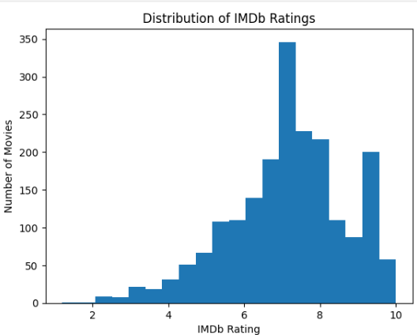
UNIVARIATE ANALYSIS
IMDb Rating Distribution
To understand the overall pattern of audience ratings and assess how movies are generally perceived on IMDb.
Observations :
  IMDb ratings are concentrated in the 6–9 range, indicating moderate to strong audience approval
  Extremely low-rated movies are uncommon
  Very high ratings (above 9) are rare, showing that exceptional audience approval is difficult to achieve

Slide 9
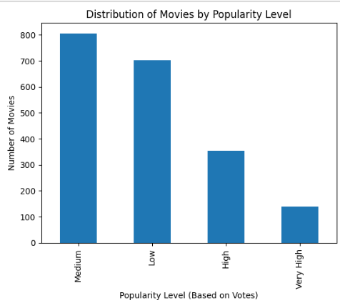
UNIVARIATE ANALYSIS
Popularity (IMDb Votes) Distribution
To understand how audience engagement (measured through IMDb votes) is distributed across movies.
Observations :
  Majority of movies fall under Low to Medium popularity levels
  Only a small fraction of movies achieve Very High popularity
  Audience attention is unevenly distributed across films

Slide 10
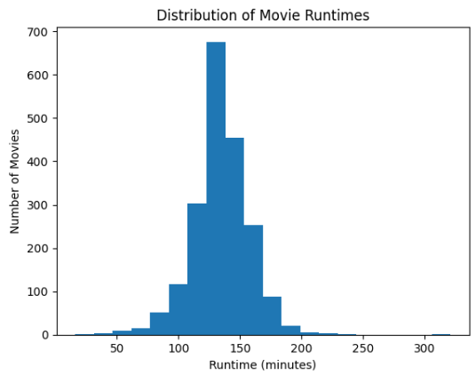
UNIVARIATE ANALYSIS
Movie Runtime Distribution
To examine how movie durations are distributed and identify commonly used runtime ranges in the film industry.
Observations :
  Most movies have runtimes between 120 and 150 minutes
  Very short movies (below 90 minutes) are relatively few
  Extremely long movies (above 180 minutes) are uncommon

Slide 11
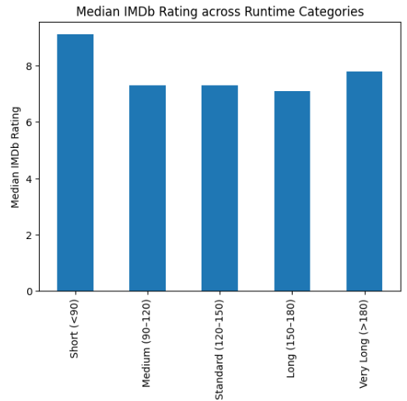
BIVARIATE ANALYSIS
Runtime vs IMDb Rating
To understand how movie duration influences audience ratings
Observations :
  Movies with standard runtimes (120–150 minutes) receive higher median IMDb ratings
  Very short and very long movies show lower or inconsistent ratings
  Audience appreciation is not linear with runtime

Slide 12
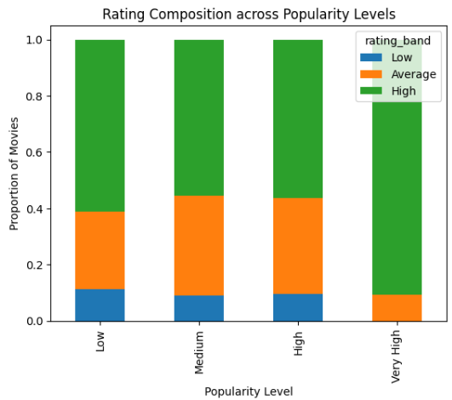
BIVARIATE ANALYSIS
Rating Composition across Popularity Levels
To analyze how audience ratings are distributed across different levels of movie popularity.
Observations :
  Low popularity movies show mixed ratings, indicating inconsistent audience response.
  Medium popularity movies include many well-rated films, showing quality does not require extreme popularity.
  High popularity movies still have mixed ratings, meaning reach does not always imply quality.
  Very high popularity movies are mostly well-rated, but they are few in number.

Slide 13
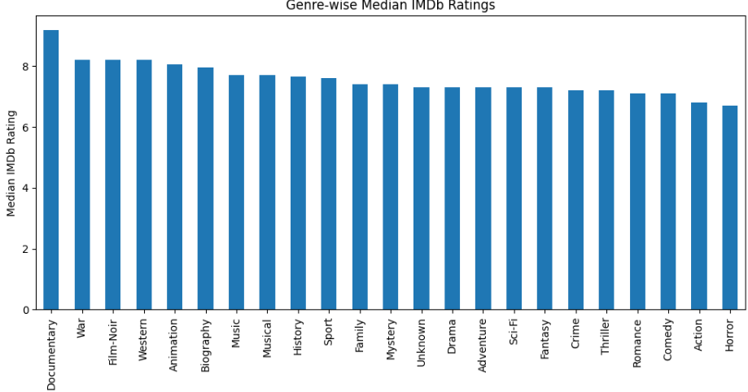
BIVARIATE ANALYSIS
Genre-wise Audience Acceptance
To compare audience ratings across different movie genres.
Observations :
  Documentary has the highest median IMDb rating, indicating strong audience appreciation.
  War, Film-Noir, Western, and Animation also show consistently high median ratings.
  Drama, Thriller, Crime, and Sci-Fi fall in the mid-range with stable audience response.

Slide 14
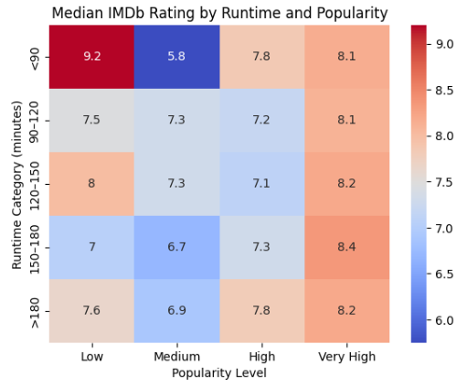
MULTIVARIATE ANALYSIS
Runtime × Popularity × IMDb Rating
To analyze how runtime and popularity together influence audience ratings.
Observations :
  Movies with standard runtimes (120–150 min) achieve higher ratings across popularity levels
  Very short and very long movies perform inconsistently, even when popular
  Popularity alone does not compensate for unfavorable runtime choices

Slide 15
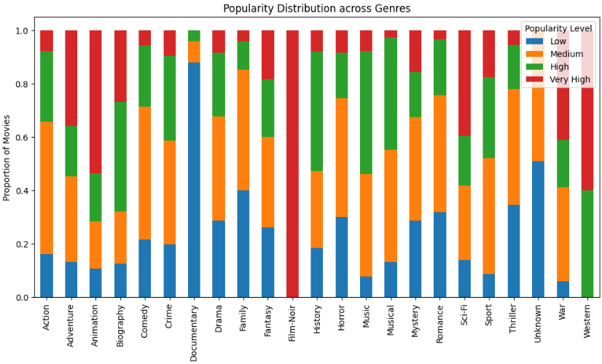
MULTIVARIATE ANALYSIS
POPULARITY DISTRIBUTION ACROSS GENRES
To understand how audience popularity varies across different movie genres.
Observations :
  Documentary and Film-Noir show a higher proportion of low popularity, indicating niche audience reach.
  Action, Comedy, and Romance contain a larger share of high and very high popularity movies, reflecting mass appeal.
  Drama and Thriller exhibit a balanced mix of popularity levels, suggesting consistent audience engagement.

Slide 16
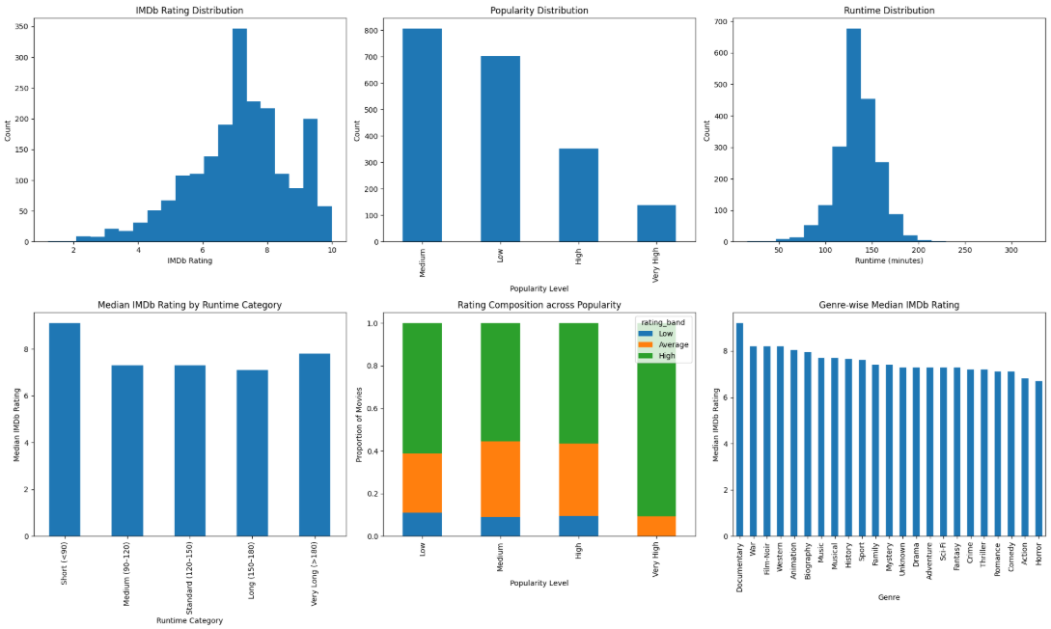

Slide 17
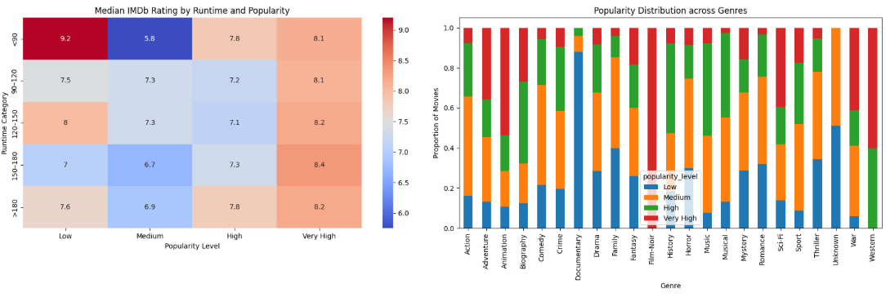

Slide 18
Hypothesis Testing - 1
Director Success vs Genre
Hypothesis :
  H₀: Director’s movie success is independent of genre
  H₁: Director’s movie success depends on genre
Method :
  Test Used: Chi-Square Test of Independence
  Variables:
    Director (Christopher Nolan)
    Genre
    Movie Success (Based on IMDb Rating)
Conclusion
The null hypothesis is rejected, indicating that the director’s success varies across genres.

Slide 19
Hypothesis Testing - 2
Runtime Category vs IMDb Rating
Hypothesis :
  H₀: Mean IMDb ratings are the same across all runtime categories
  H₁: Mean IMDb ratings differ across runtime categories
Method :
  Test Used: One-Way ANOVA
  Independent Variable: Runtime Category
  Dependent Variable: IMDb Rating
Result
  p-value: 1.16 × 10⁻⁷
Since the p-value is less than 0.05, the null hypothesis is rejected.
Conclusion
IMDb ratings differ significantly across movie runtime categories.

Slide 20
Hypothesis Testing - 3
Genre vs IMDb Rating
Hypothesis :
  H₀: Mean IMDb ratings are the same across all genres
  H₁: Mean IMDb ratings differ across genres
Method :
  Test Used: One-Way ANOVA
  Independent Variable: Genre
  Dependent Variable: IMDb Rating
Result
  One-way ANOVA shows a statistically significant difference in IMDb ratings across genres
  p-value < 0.05, leading to rejection of the null hypothesis
Conclusion
Audience ratings vary significantly across different movie genres

Slide 21
Hypothesis Testing - 3
Genre vs IMDb Rating
Hypothesis :
  H₀: Mean IMDb ratings are the same across all genres
  H₁: Mean IMDb ratings differ across genres
Method :
  Test Used: One-Way ANOVA
  Independent Variable: Genre
  Dependent Variable: IMDb Rating
Result
  One-way ANOVA shows a statistically significant difference in IMDb ratings across genres
  p-value < 0.05, leading to rejection of the null hypothesis
Conclusion
Audience ratings vary significantly across different movie genres

Slide 22
Insights
Audience Ratings Pattern
  Most movies receive IMDb ratings between 6 and 8
  Extremely high ratings are rare
  Average-to-good ratings are the industry norm
Popularity Distribution
  Majority of movies fall under Low to Medium popularity
  Very High popularity (blockbusters) are rare
Runtime Effect on Ratings
  Movies with standard runtimes (120–150 minutes) consistently achieve better ratings
  Very short and very long movies show weaker or inconsistent ratings

Slide 23
Insights
Popularity vs Rating Relationship
  High popularity does not always correspond to high ratings
  Many well-rated movies exist at medium popularity levels
Genre-wise Audience Acceptance
  Documentary, War, Film-Noir, Western genres show higher median ratings
  Action, Comedy, Horror show lower and more variable ratings
Genre-wise Popularity Distribution
  Action, Comedy, Romance attract higher popularity
  Documentary and Film-Noir attract niche audiences

Slide 24
Business Recommendations
  Prioritize genres with consistent audience ratings, not just high popularity
  Target 120–150 minutes as the safest runtime range
  Do not rely solely on popularity metrics for decision-making
  Medium-popularity films can still deliver strong audience satisfaction
  Assign directors to genres where they have demonstrated past success
  Mid-budget, well-crafted films offer a safer risk–reward balance
Movie success is driven by a combination of genre choice, optimal runtime, and content quality rather than popularity alone, and data-driven decision-making can significantly reduce production risk.

Slide 25
Challenges Faced
  Dynamic website structure: IMDb pages change dynamically, making element identification challenging during web scraping
  Handling missing values: Several fields contained missing data, requiring careful preprocessing without losing important information
  Highly skewed popularity data: IMDb votes were extremely skewed, making direct analysis difficult
  Multi-genre movies: Movies belonging to multiple genres required restructuring the dataset for accurate genre-wise analysis
  Choosing appropriate visualizations: Selecting clear and meaningful plots while avoiding misleading representations
  Statistical decision making: Selecting suitable hypothesis tests and validating assumptions correctly

Slide 26
Conclusion
  Movie success is influenced by multiple interacting factors, not popularity alone
  Genre selection and runtime play a crucial role in audience acceptance
  Movies with standard runtimes (120–150 minutes) consistently perform better
  High popularity does not guarantee high audience ratings
  Directors show genre-specific success patterns, highlighting the importance of alignment
  Data-driven decision-making can significantly reduce production risk

Slide 27

THANK YOU

